Slide 1
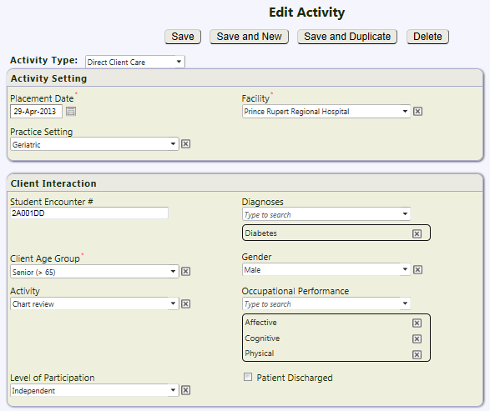
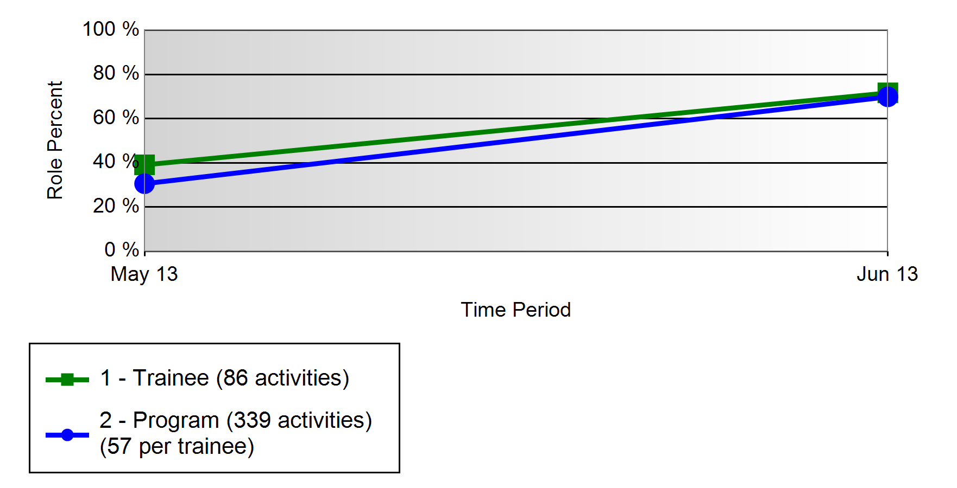
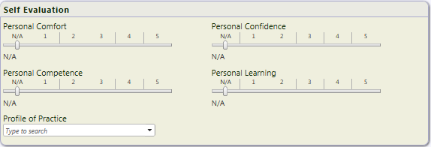
Bridging the gap between theory and practice: Implementation of T-RES for occupational therapy fieldwork placements
Donna Drynan¹, Laura Bulk², Devon Cochrane², Stephanie Crozier², Kris Kent², Cloe Whittaker², Luisa Yu²,
Senior Instructor, Department of Occupational Science and Occupational Therapy¹; Master of Occupational Therapy Student²,
University of British Columbia, Vancouver, BC
Project Purpose
What is T-res?
Feedback from students
In the Master of Occupational Therapy program, students complete over 1000 hours of fieldwork (31 weeks in total) as part of their training. Currently, there is no method to track their individual placement experiences or a method for them to systematically reflect on these experiences. This project will provide (a) the tool for occupational therapy students to track placement activities with accuracy, which in turn will be fed back to the placement coordinator so that the placement matching process can be strengthened, and (b)an easy to use tool to support students’ personal reflection.
Educational Tool
Evaluation Tool
Positives
Students record concrete information about training experiences related to specific clinical and academic objectives
Uses the information to support reflective learning and develop learning portfolios
Ensures students meet educational goals regardless of placement location
Identifies gaps in training and knowledge
Identifies the roles played by students during patient encounters and details whether the patients are real or simulated
Preceptor evaluations of students can be done at the encounter level and integrated with student self-evaluations on an ongoing basis
Easy to fill in screens
Made me think about what I was doing
Really liked the “save & duplicate” feature as that sped up entries when you were seeing the same client again
Simple interface
All six reported liking the reflection feature as it was immediate and submitted to instructor seamlessly
3/6 reported liking the “self assessment” scale
Level activity was performed at
(supervision to independence)
Set-up and pilot testing
Challenges
Too much else to do on placement
Sometimes took longer than I thought
Hard to keep up with entries in a busy acute care setting
No way to indicate if I was working with a group
Might have been easier if a template was provided for the refection section
hard to remember how to login
Meetings with representative from Resilience software to set-up the template for OT data collection
Attention paid to ensuring student entry fields were meaningful to students, would allow them to link a model of OT to the clinical encounters, and would produce reports that would be useful
Meeting with group of students twice before trial with system and once post placement to debrief experience and make an necessary adjustments to the system
Communication Tool
Planning Tool
Students can see the objectives they are expected to achieve
Faculty can review and discuss records of actual activities, gaps in experience and evaluations with individual students
The OT Academic Fieldwork Coordinator (AFC) can plan future placements taking into account:
accurate experiences of OT Students
teaching style and areas of expertise of Preceptors
student placement profiles
AFC can assess the actual educational content of the placements and realize:
accurate redirection of resources to enhance student experiences as well as maximize efficiency
shorter response times for implementing program improvements
an effective measurement system for monitoring and assessing program modifications
AFC can verify that OT Students in different locations are having comparable experiences
AFC can demonstrate compliance for accreditation requirements
recommendations
Student report examples
Modifications were made to system based on student feedback (included a group option; added some diagnosis)
Modified the required number of reflections to be submitted during each placement block
Ensure that adequate orientation and training is provided on the system to all students
Provide templates for guiding reflection entries- optional for students to use
Consider “near peer” evaluation of reflective entries- senior students providing feedback to junior students during the level 1 placement
Suggest ways for students to keep track of their activities if they cannot get to T-RES daily
Level of participation in a client encounter
(supervision to independence)
Details of Occupational Performance- was student working at the person, environment or occupation domain
Summary of activities within
each occupational performance domain
Diagnoses
Clinical experience by age group and setting
Reflection Summary
Direct Client Care | Number
ADL Assessment (Showering, Kitchen, Bathing) | 167
Transfer Training | 100
Chart Review | 55
Ambulation Assessment (Balance, Intervention) | 44
Cognitive intervention sessions | 46
Cognitive intervention sessions | 44
Determining Equipment needs | 33
Initial Interviews | 33
Trainee Name | Activity Count- Direct Client Care
Student 1 | 174
Student 2 | 118
Student 3 | 194
Student 4 | 150
Student 5 | 44
Student 6 | 53

