Slide 1
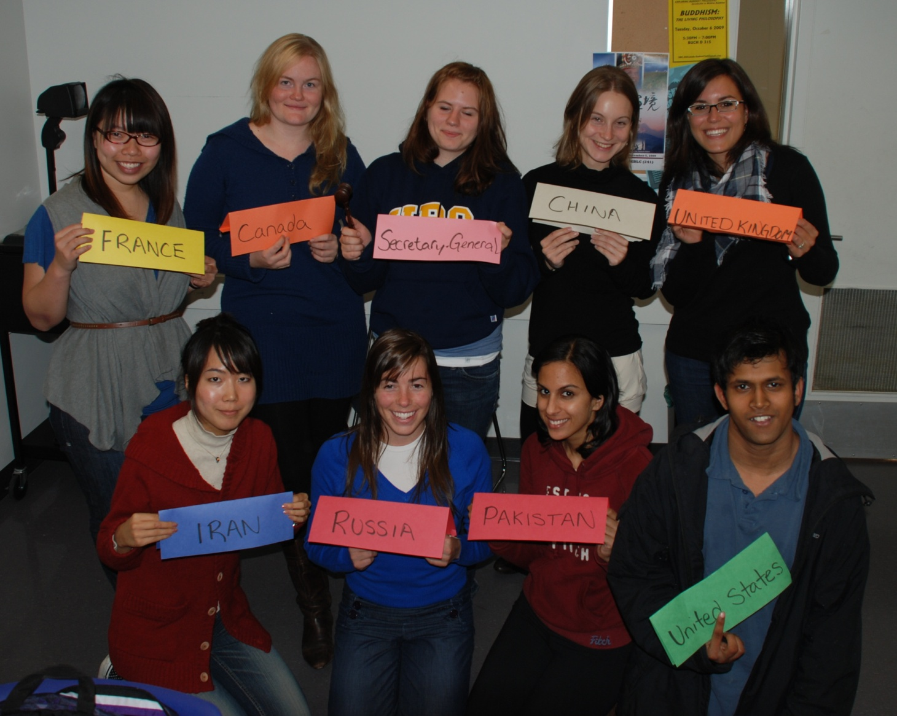
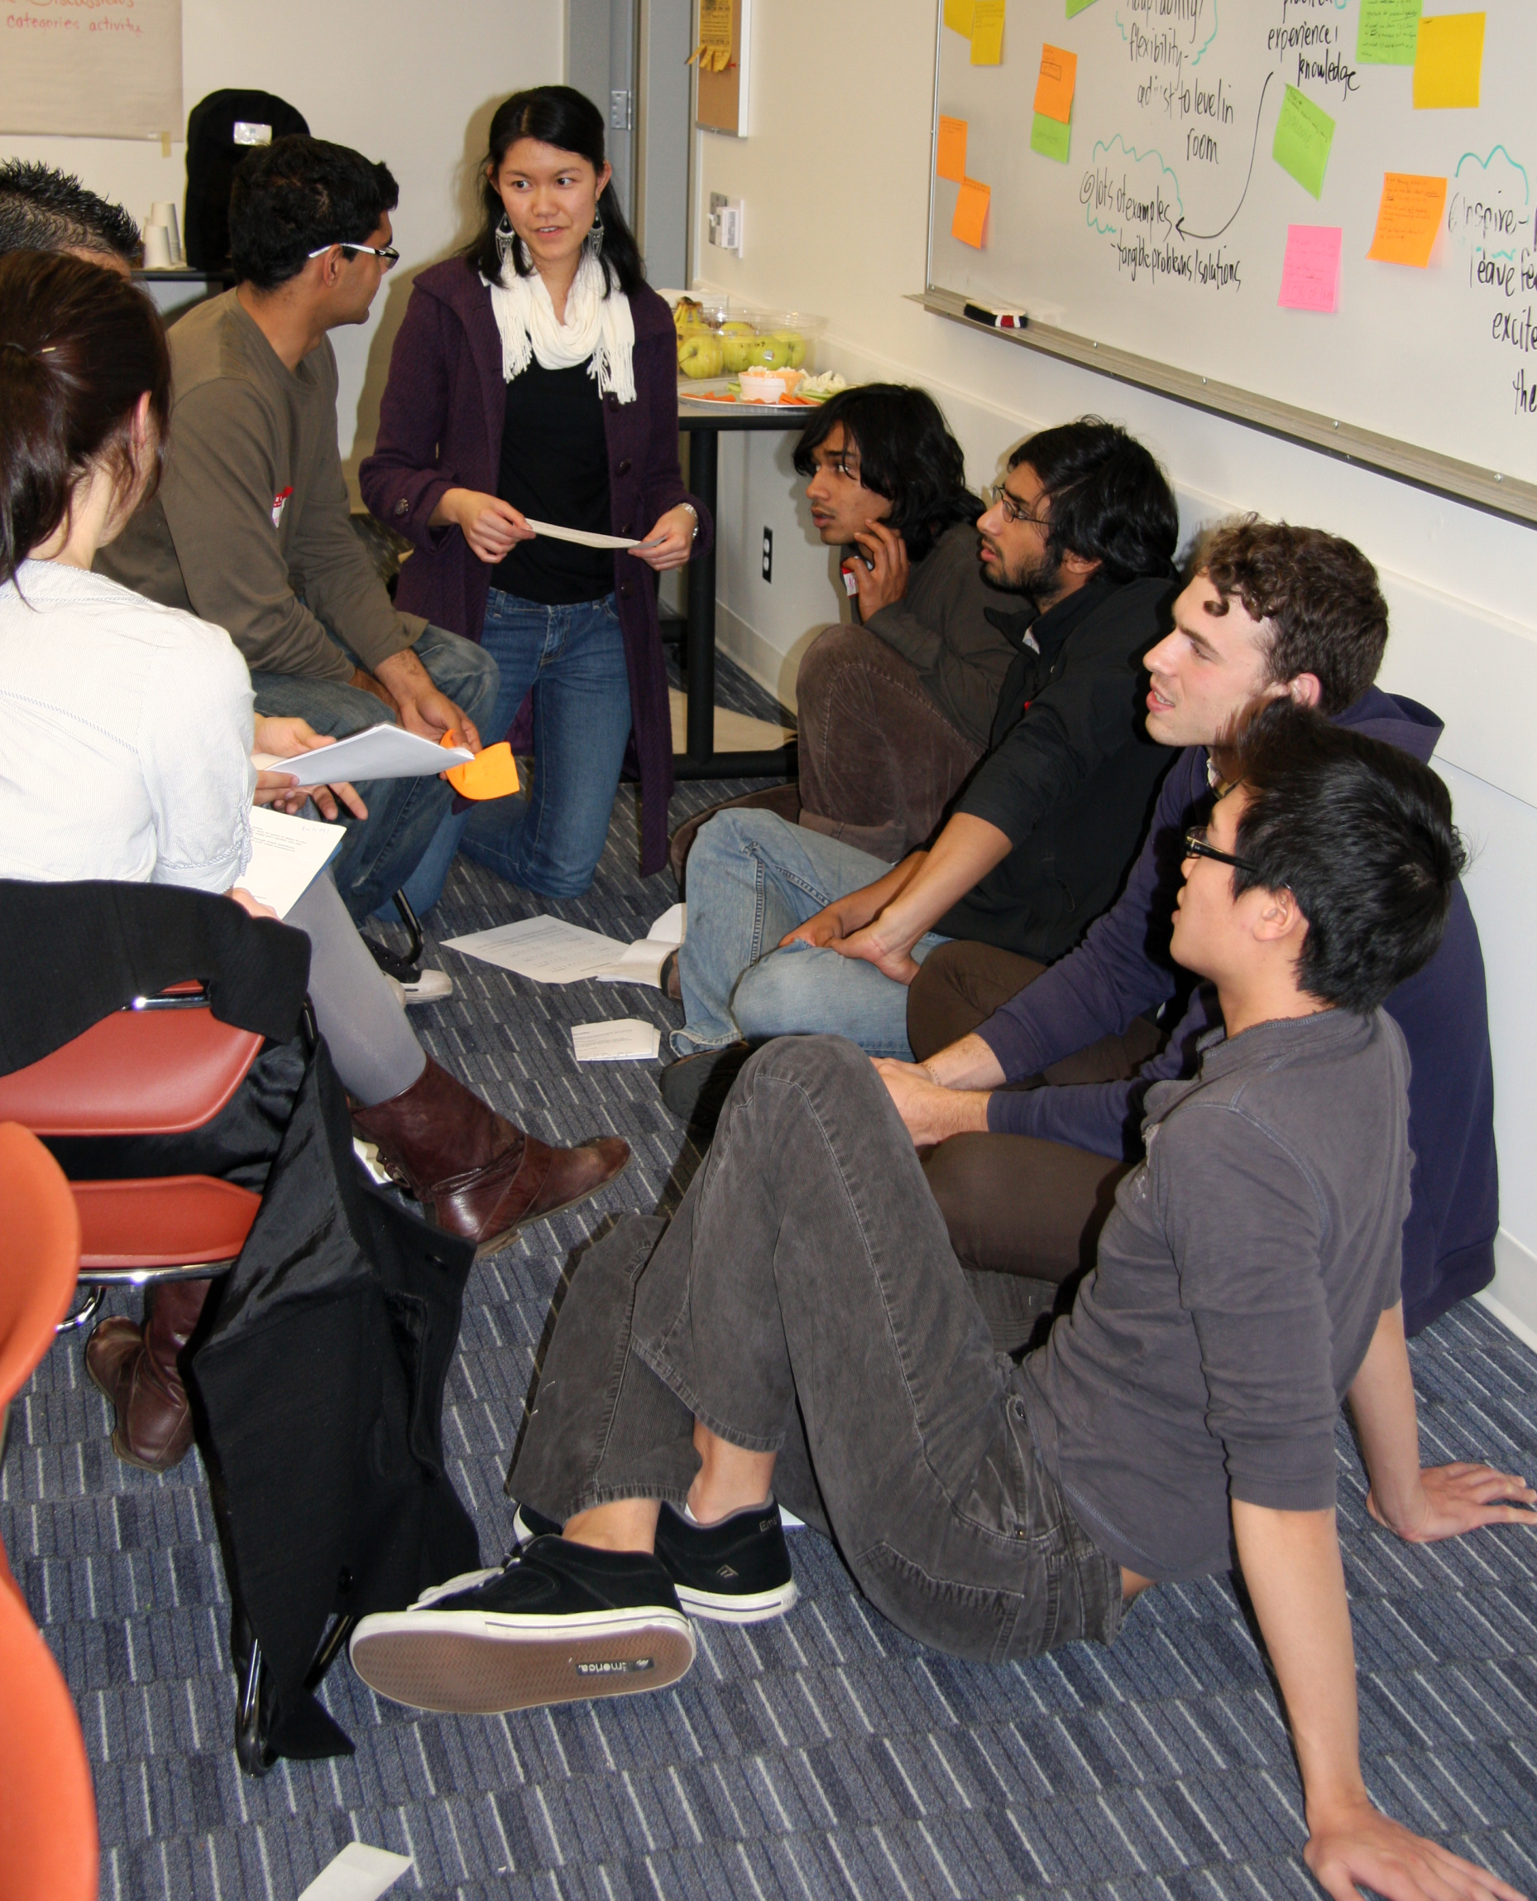
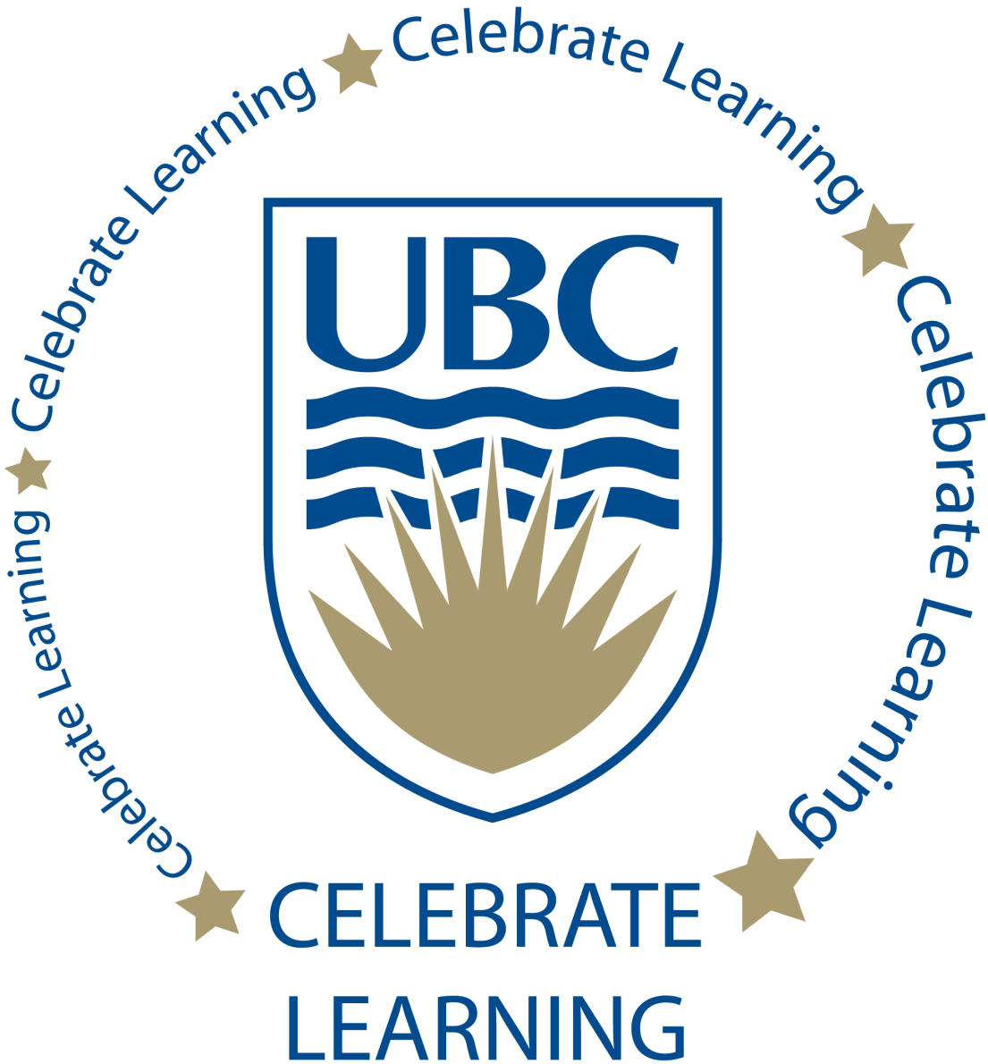
Student Directed Seminars
The Student Directed Seminars program allows senior undergraduate students to initiate and coordinate small, collaborative, group learning experiences for other upper level students.
With the support of a Faculty Sponsor, and approval from the Advisory Committee, a course coordinator designs and facilitates a course on any topic of interest to them, not currently offered at UBC.
Eight to fifteen students participate in each course, and gain 3 upper-level credits, just like any other class offered at UBC. Involve yourself as a course participant, course coordinator, or both!
The only program of its kind in Canada, the Student Directed Seminars Program is an exciting opportunity allowing you to take charge of your own education, and meet other like minded students.
Student participation by Faculty/School: (2010-2011)
Faculty/School | #
Arts | 121
Science | 52
LFS | 14
Kinesiology | 10
Sauder | 9
Engineering | 9
Pharmacy | 1
Unclassified | 10
total | 226
2011-2012 Seminars:
Birth, Breastfeeding, & Maternity Care from a Feminist Perspective
Books on Trial: Modernism, Aesthetics, + Obscenity
Challenging ideas and Today’s Science
Design for a Sustainable World
Development of the Modern State and Sexuality
Emerging Technologies and Business
Immigration and Multicultural Community Development: A Community‐Based Evaluation Research Approach
Multiculturalism: Myth, Menace or Wave of the future?
Rationality + Human Decision Making
Reading Hegel’s Phenomenology of Spirit
The Case for Dramaturgy in Business
The Ethics of Tourism
The Politics of Food: History and Theory of North American Cultivation
Understanding Canadian Identity Through Representations of Food
United Nations & Diplomacy
Urban Politics: The Changing Role of the City
Visit our website for full course descriptions
ASTU 400U: United Nations and Diplomacy
SDS Student Coordinator Training Program
For more information: studentdirectedseminars.ubc.ca
sds.coordinator@ubc.ca

