Slide 1
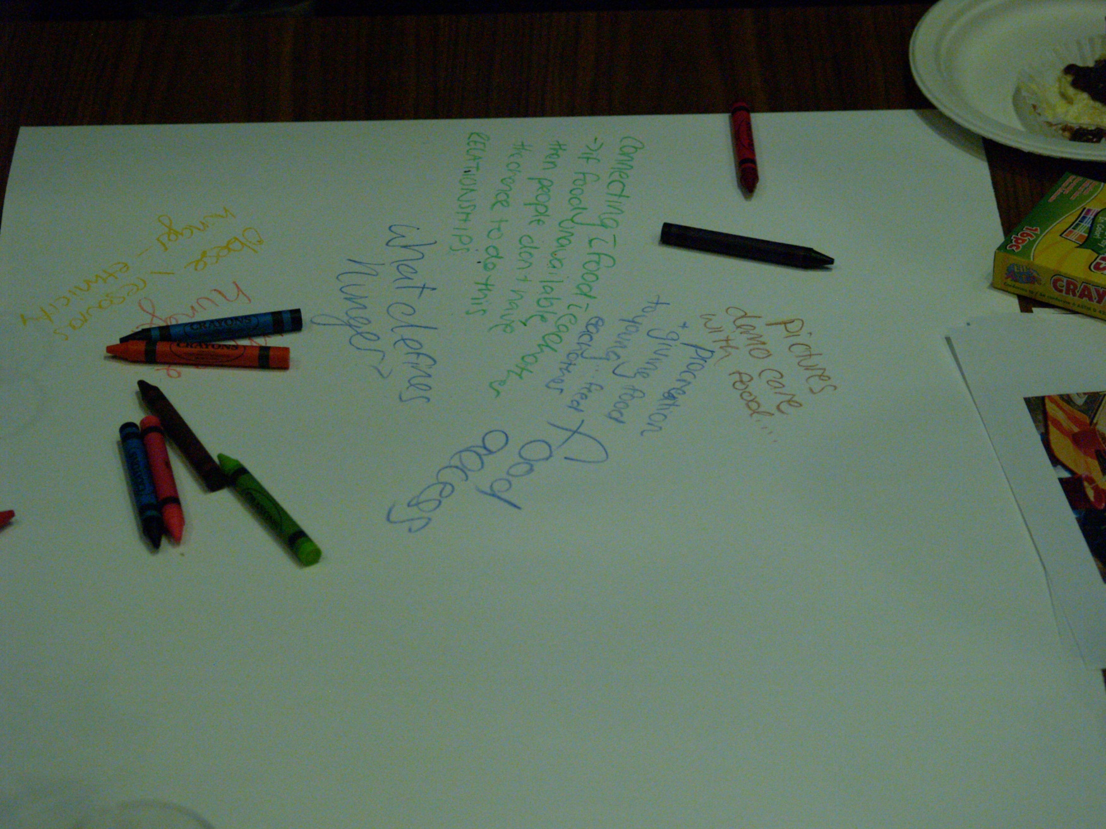
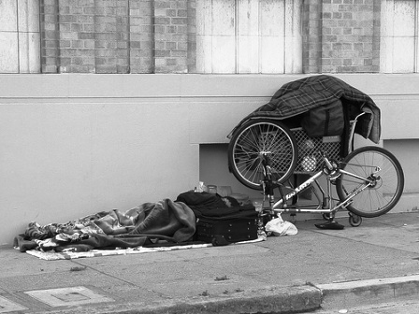
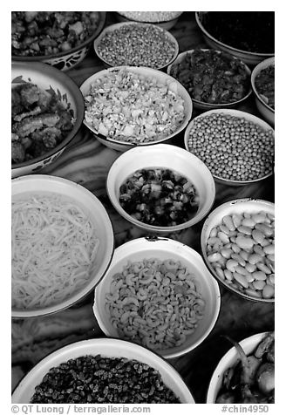
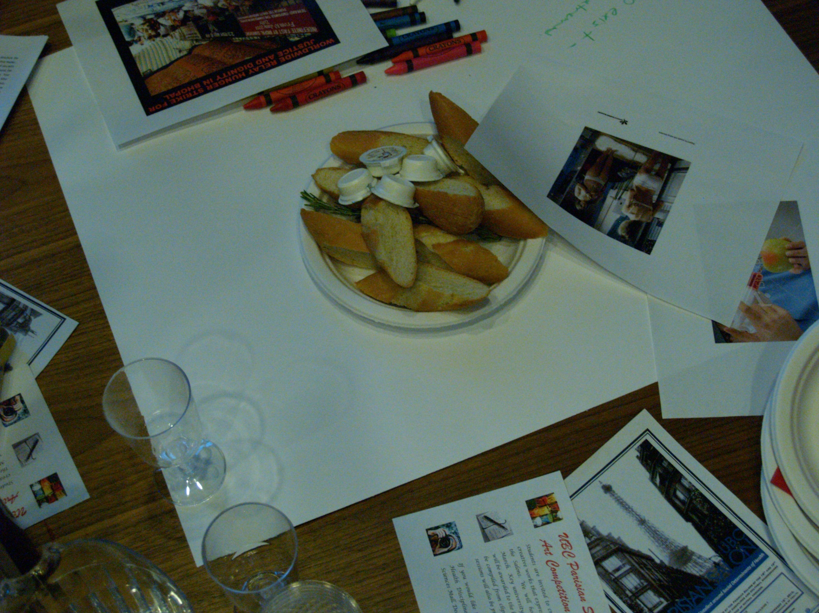
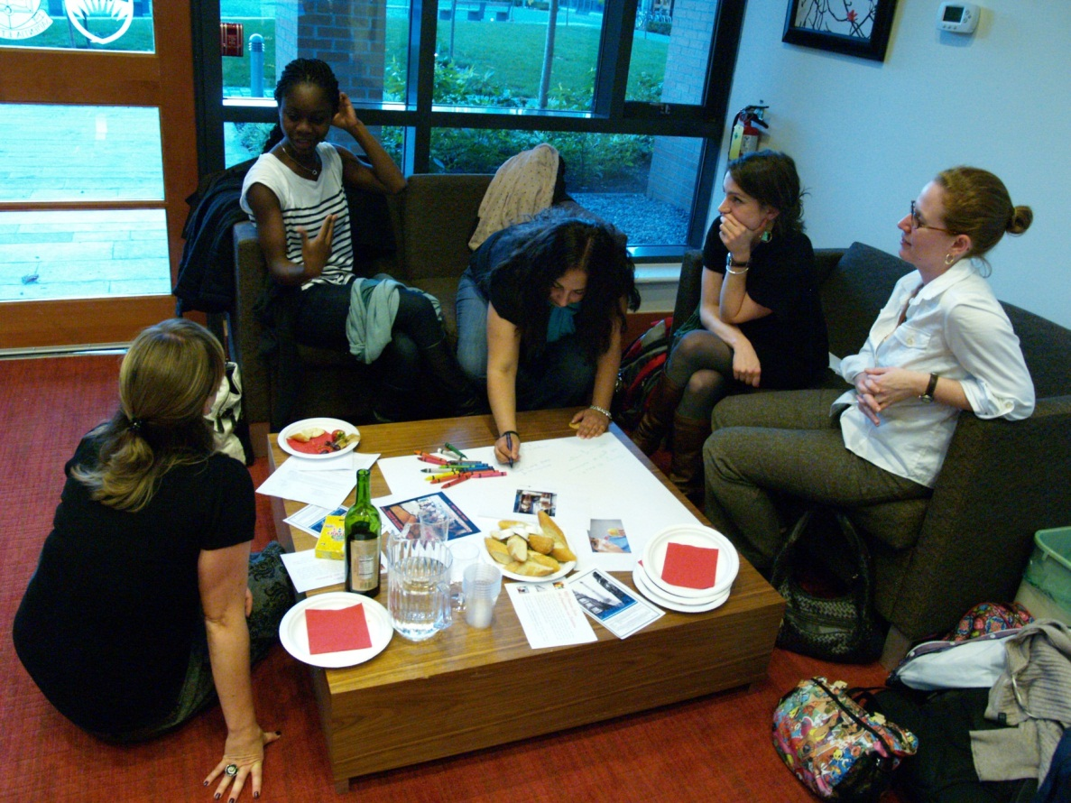
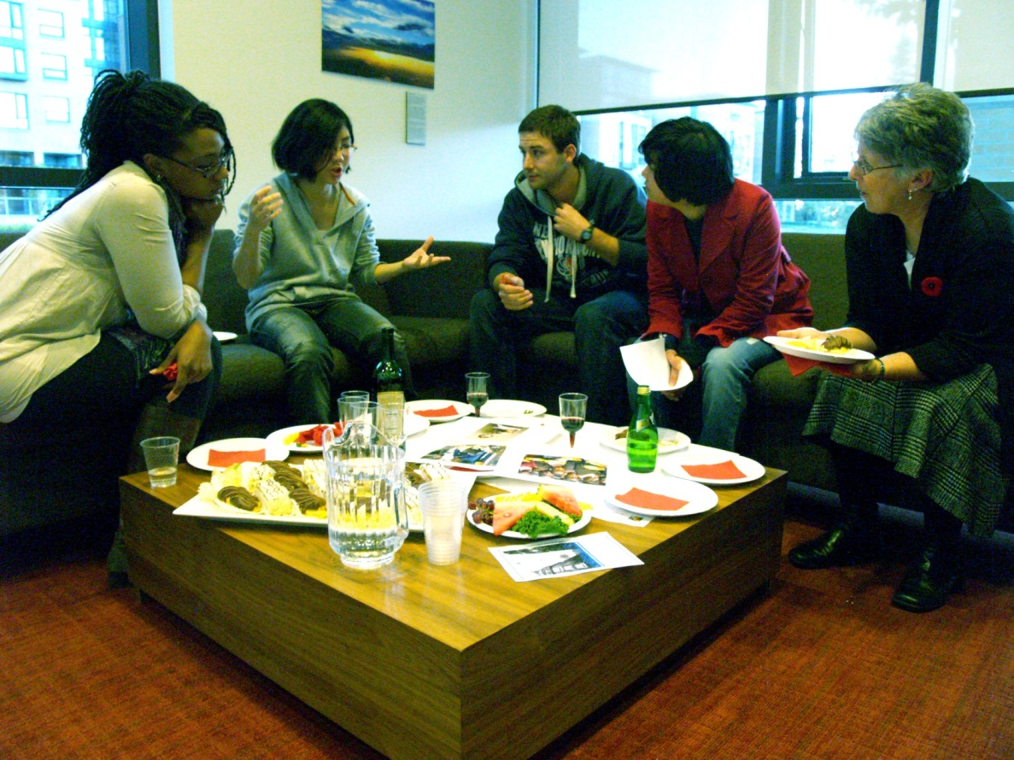
In an increasingly global society, students from a wide range of disciplines will take on roles in which they will contribute to the health and wellbeing of the world’s diverse populations. An understanding of the social determinants of health is integral to this.
Creating a Safe and Comfortable Environment for Dialogue
Over refreshments, as is the tradition of the ‘Parisian Salon’, students are invited to engage in meaningful discussion around areas of common concern related to the health and wellbeing of society.
Topics of Discussion
The key to the success of this initiative has been student leadership. With support from the College of Health Disciplines at UBC, a group of dedicated students representing different disciplines from across campus meet periodically to plan the sessions and identify topics for discussion. Topics to-date include:
• Access to food
• Access to housing
• Access to education
• Technology
• Gender
Language
Economic Downturn
A World Café Approach
Meeting over refreshments, sometimes at a pub on campus or another relaxing environment on campus, allows students to sit comfortably in small groups.
Each table is hosted by a ‘facilitator’ who introduces a story, article or image to stimulate discussion around the topic of discussion.
Upon completion of one conversation round, the host remains at the table and participants travel to another table.
The host welcomes them and briefly updates them on the ideas collected by the previous group.
After successive rounds of discussion, new interesting conversation patterns arise.
After several rounds of conversation, a big debriefing is held where a synthesis of the discoveries is presented in a whole group conversation.
Through this World Café approach, collective knowledge grows and possibilities for actions emerge.
Creating a Culture of Intellect Around the Social Determinants of Health
Bringing Together Students from Different Disciplinary and Cultural Back Grounds
Having participants from a wide range of disciplines, including health and non-health related, enables students to explore how different disciplines approach a particular health concern and allows students to see themselves in the solutions.
Inspired by the Parisian Salons of the 18th and 19th Centuries
A salon, of the type held in Paris during the 18th and 19th Centuries, is “a gathering of intellectual, social, political, and cultural elites under the roof of an inspiring hostess or host, partly to amuse one another and partly to refine their taste and increase their knowledge through conversation”.
(http://en.wikipedia.org/wiki/Salon)
Hosted by the College of Health Disciplines with support from the UBC Teaching and Learning Enhancement Fund.
Lesley Bainbridge, Victoria Wood, Shafik Dharamsi, Jordana Comazzeto, Sasha Bossley, Julia Lammer, Susan Gardiner, Linda Liu

